Slide 1
Fine-Tuning Tasks
Microsoft Project 2016
Lesson 5

Slide 2
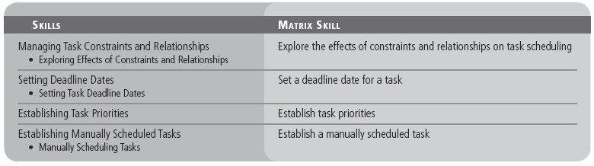
Objectives

Slide 3
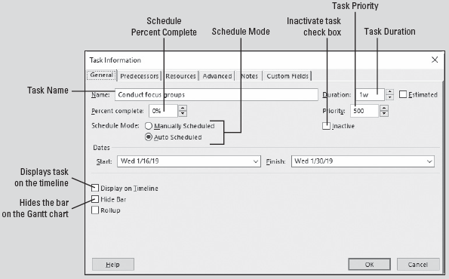
Software Orientation
The General tab of the Task Information dialog box provides general information, and allows you to make changes and updates to a task.
You can edit the task name, update the duration and the percent complete, change the priority, and modify the start and finish dates.
Notes:
General tab of the Task Information dialog box

Slide 4
Managing Task Constraints and Relationships
As you are building a project schedule, you will usually use both task relationships and constraints within the schedule.
You can control how Microsoft Project schedules these elements.
Microsoft Project alerts you to conflicts between relationships and constraints, so that you can maintain control over the rules that Microsoft Project follows.
It is important to make sure that you understand the effects of the constraints you apply on the overall project schedule—not just on the task to which you have applied the constraint.

Slide 5
Exploring Effects of Constraints and Relationships
In the following exercise, you will review two of the basic elements of scheduling—constraints and task relationships—and you will learn how to control the actions of Microsoft Project when there is a conflict between a constraint and a task relationship.
Microsoft Project always honors constraint dates over task relationships by default, even if this causes negative float (slack).
It is a good idea to develop a consistent strategy for using constraints and relationships in your projects. A best practice is using the default behavior of honoring constraint dates, unless there is a project or situation‐specific reason to do otherwise.
As you learned in previous lessons, you should always set task relationships in your projects, and then apply semi‐flexible or inflexible constraints only when truly necessary.
Notes:
More Info: For a review of task constraints and negative slack, refer to Lesson 4. The best way to prevent negative float is through the use of leads and lags, which will be discussed in detail in Lesson 13.

Slide 6
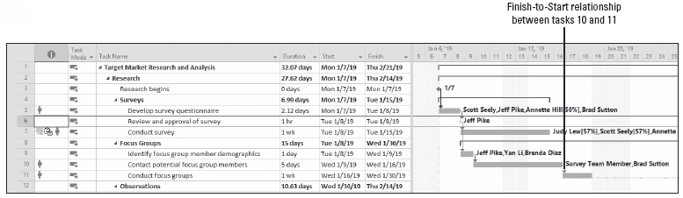
Step-by-Step: Explore the Effects of Constraints and Relationships on Task Scheduling
GET READY. Before you begin these steps, open Tailspin Remote Drone 5M from the data files for this lesson. SAVE the file as Tailspin Remote Drone 5 in the solutions folder.
In the Gantt Chart view, review the finish‐to‐start relationship between tasks 10 and 11. Your screen should look similar to the figure below.
Notes:
Gantt Chart view showing finish‐to‐start relationship between tasks 10 and 11

Slide 7
Step-by-Step: Explore the Effects of Constraints and Relationships on Task Scheduling
You have just been told that task 11 must begin no later than Monday, January 14, 2019. In the Task Name column, select the name of task 11, Conduct focus groups.
On the Task ribbon, in the Properties group, click the Information button.
In the Task Information dialog box, click the Advanced tab.
In the Constraint Type box, select Start No Later Than. In the Constraint Date box, key or select 1/14/19.
Click OK. The Planning Wizard notifies you of a scheduling conflict between the constraint you applied to task 11 and the existing task relationship between tasks 10 and 11. Your screen should look like the figure on the next slide.

Slide 8
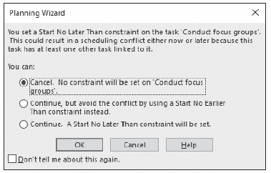
Step-by-Step: Explore the Effects of Constraints and Relationships on Task Scheduling
In the You Can: selection list, click Continue. A Start No Later Than constraint will be set.
Click OK.
Notes:
Planning Wizard dialog box

Slide 9
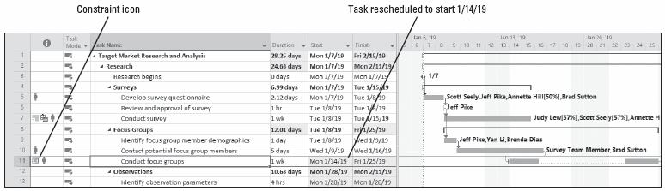
Step-by-Step: Explore the Effects of Constraints and Relationships on Task Scheduling
A second alert appears. Click Continue. Allow the scheduling conflict and click OK. Microsoft Project applies the SNLT constraint to task 11 and reschedules it to start on Monday, 1/14/19, as shown in the figure below. Microsoft Project would reschedule task 11 to avoid the negative slack between tasks 10 and 11, but this SNLT constraint prevents Microsoft Project from doing so.
Notes:
Gantt chart with SNLT constraint applied

Slide 10
Step-by-Step: Explore the Effects of Constraints and Relationships on Task Scheduling
Click the File tab and then click Options.
Select the Schedule options and then navigate to the Scheduling options for this project: section. Your screen should look similar to the figure on the next slide.
Clear the Tasks will always honor their constraint dates check box and then click OK. A calendar alert icon appears in the Indicators column for task 11.
Rest the mouse pointer on the calendar alert icon in the Indicators column. A ScreenTip appears. Now, Microsoft Project honors the task relationship over the constraint. Microsoft Project preserves the constraint information, but does not honor the constraint. If the scheduling conflict is removed (by a change in task duration, for example), Microsoft Project would then honor the constraint.

Slide 11
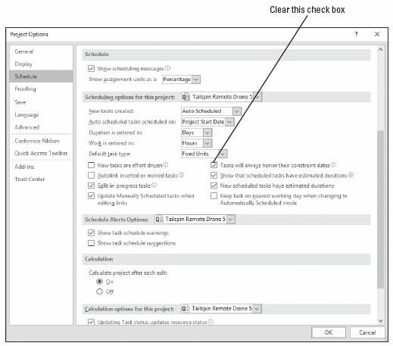
Step-by-Step: Explore the Effects of Constraints and Relationships on Task Scheduling
Notes:
Scheduling Options dialog box

Slide 12
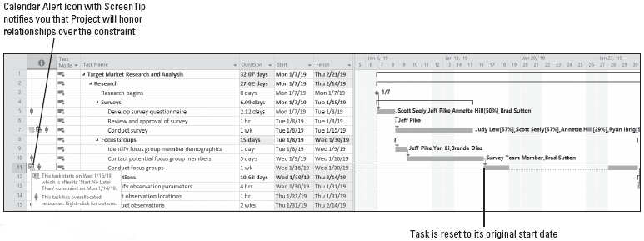
Step-by-Step: Explore the Effects of Constraints and Relationships on Task Scheduling
After Step 13, your screen should look like the figure below.
Notes:
Calendar alert and ScreenTip

Slide 13
Step-by-Step: Explore the Effects of Constraints and Relationships on Task Scheduling
Click the File tab again and then click Options. Select the Schedule options and then navigate to the Scheduling options for this project section.
On the Schedule tab, click the Tasks will always honor their constraint dates check box and then click OK. This restores the default behavior to Microsoft Project, and task 11 is rescheduled to honor its constraint date.
SAVE the project schedule.
PAUSE. LEAVE Project open to use in the next exercise.

Slide 14
Setting Deadline Dates
A deadline is a date value you enter for a task that indicates the latest date by which you want the task to be completed. The deadline date itself does not constrain the task.
When you enter a deadline date, Microsoft Project displays a deadline marker on the Gantt chart and alerts you if the task’s finish date moves beyond the deadline.
Assigning a deadline date to a task, rather than a semi‐flexible or inflexible constraint, allows the most flexibility in scheduling tasks with commitments.
Using semi‐flexible or inflexible constraints can cause schedule inflexibility. A better approach to scheduling is to use the default As Soon As Possible (ASAP) constraint and then enter a deadline for the task.
Notes:
In the following exercise, you will enter a deadline date for a task rather than entering a constraint.

Slide 15
Step-by-Step: Set a Deadline Date for a Task
GET READY. USE the project schedule you created in the previous exercise.
Press the F5 key; the Go To dialog box appears.
In the ID box, key 27 and then click OK. Microsoft Project displays task 27. You want to make sure that the preproduction tasks conclude by February 22, 2019, so you will enter a deadline date for this milestone.
Double‐click the task name of task 27, Analysis complete. The Task Information dialog box appears.
Click the Advanced tab if it is not already selected.

Slide 16
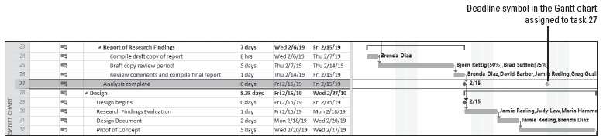
Step-by-Step: Set a Deadline Date for a Task
In the date box next to Deadline, key or select 2/22/19 and then click OK. Microsoft Project inserts a deadline marker in the chart portion of the Gantt Chart view. Your screen should look similar to the figure below.
Notes:
Take Note: If the scheduled completion of a task moves past the deadline date, Microsoft Project displays a missed deadline indicator in the Indicators column. To remove a deadline from a task, clear the Deadline field on the Advanced tab of the Task Information dialog box.

Slide 17
Step-by-Step: Set a Deadline Date for a Task
Double‐click the name of task 28, Design. The Task Information dialog box appears. Click the Advanced tab if it is not already selected.
In the drop‐down date box next to Deadline, key or select 3/8/19 and then click OK. Microsoft Project inserts a deadline date marker for the summary task. Scroll the chart portion of the Gantt Chart view to the right to view the marker.
SAVE the project schedule.
PAUSE. LEAVE Project open to use in the next exercise.
Notes:
Take Note: A deadline date causes Microsoft Project to notify you if the scheduled completion of a task exceeds its deadline date. Entering a deadline date has no effect on the scheduling of a summary or subtask, except for one situation. The one instance in which the deadline date can affect the scheduling of a summary task (or any task) involves slack. When a task is assigned a deadline date, its slack does not extend beyond the deadline date.

Slide 18
Establishing Task Priorities
Task priority is a numeric ranking between 0 and 1000 of a task’s importance. Microsoft Project uses task priorities to determine which tasks can be delayed in order to resolve periods of resource overallocation.
The default task priority Microsoft Project assigns is 500. Task priorities only affect the schedule during resource leveling and have no meaning regarding the urgency or importance of a task.
Resource leveling is the process of delaying a resource’s work on a task to resolve an overallocation. Depending on the options you choose, resource leveling might delay the start date of an assignment or an entire task, or split up the work on a task.
Resource leveling evaluates several factors to determine how to resolve resource overallocation.
Notes:
In the next exercise, you will set the priority for a task, giving it the highest priority possible in Microsoft Project (1000). A task with a priority of 1000 is never delayed by leveling.

Slide 19
Establishing Task Priorities
One of the factors evaluated during resource leveling is task priorities. When you level resources, Microsoft Project will delay a task with a lower priority before delaying a task with a higher priority in order to resolve a resource overallocation:
Tasks with priority 0 are leveled first, so they are likely to be delayed by leveling.
Tasks with priority 1000 are never delayed by leveling. Assign this task priority carefully, as it limits Microsoft Project’s capabilities to resolve resource overallocations.
Notes:
More Info: You can find more information about resource leveling in Lesson 6.

Slide 20
Step-by-Step: Establish Task Priorities
GET READY. USE the project schedule you created in the previous exercise.
In the Task Name column, select the name of task 25, Draft copy review period.
On the Task ribbon, in the Properties group, click the Information button. The Task Information dialog box appears.
Click the General tab if it is not already selected.
In the Priority box, key or select 1000. Your screen should look similar to the figure on the next slide. A message at the bottom of the Task Information dialog box states the task will not be moved through either Resource Leveling or the Prevent Overallocations mode.
Notes:
Another Way: To simultaneously adjust the priority of multiple tasks, select the desired tasks by clicking and holding the Ctrl key. Click the Task Information button, click the General tab, and enter the desired priority in the priority box. Note that because you have selected multiple tasks, this dialog box is now labeled “Multiple Task Information.”

Slide 21
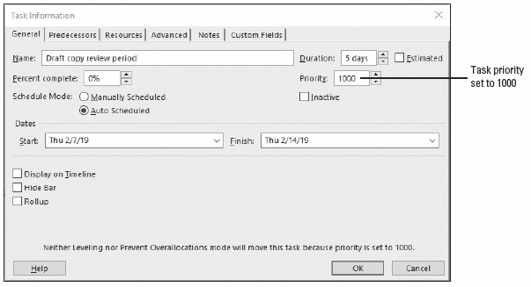
Step-by-Step: Establish Task Priorities
Click OK to close the dialog box. Microsoft Project adjusts the task’s priority.
SAVE the project schedule.
PAUSE. LEAVE Project open to use in the next exercise.
Notes:
Task Information dialog box for task 25 with task priority set to 1000

Slide 22
Establishing Manually Scheduled Tasks
Some tasks require the project manager to schedule manually, without regard to predecessors or other project constraints.
In the following exercise, you will use the new feature, Manual Scheduling, for this action. You will practice establishing a manually scheduled task.
For the purpose of this exercise, note that you have just been informed that your engineering team and manufacturing team have met and they are unsure about the outcome of the initial prototype task, as it relates to the design document and final design selection.
The task of “Initial prototype” is dependent on one but not both of these tasks. After meeting with the team, you decide to change the scheduling mode of task 37 to manual scheduling.

Slide 23
Manually Scheduling Tasks
Manually scheduled tasks are tasks that must be manually scheduled, calculated, and set by the user. These require much more attention by the project manager and might be needed at certain points of your project. They can allow you more scheduling flexibility, but they should be used sparingly.
Microsoft Project treats manually scheduled tasks much differently than auto scheduled tasks. In fact, certain features available with auto scheduled tasks are not available with manually scheduled tasks.
For example, overtime, actual overtime, and remaining overtime cannot be tracked with manually scheduled tasks. You also cannot use task constraints or work contouring.

Slide 24
Manually Scheduling Tasks
When using manually scheduled tasks, Microsoft Project treats nonworking times differently. If you use a manually scheduled task during normal working hours, on normal working days, you would not even know the difference. However, start a manually scheduled task on a nonwork day, outside of normal work hours, and then you would notice.
In essence, the system creates an exception on the calendar to close the gap between the start of the manually scheduled tasks and the next working times. You should fully understand all of the pros and cons of using manually scheduled tasks before using them in your schedules. The table on the next slide summarizes the difference between auto and manual scheduling.

Slide 25
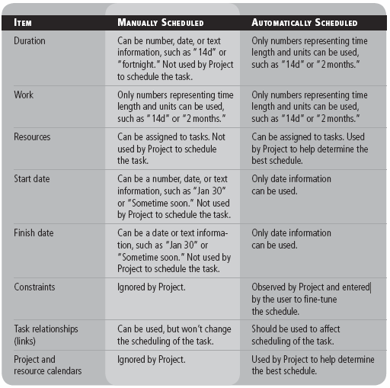
Manually Scheduling Tasks
Notes:
Items affected by manually scheduled vs. automatically scheduled tasks

Slide 26
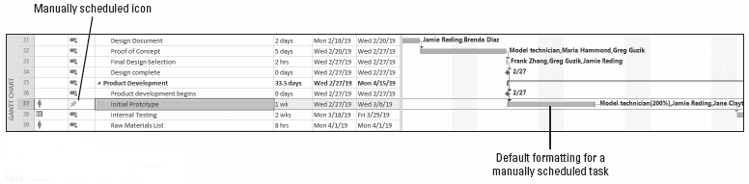
Step-by-Step: Establish a Manually Scheduled Task
GET READY. USE the project schedule you created in the previous exercise.
Press the F5 key to produce the Go To dialog box. In the ID box, key 37 and click OK.
On the Task ribbon, click the Manually Schedule button. The Gantt bar has changed to the default formatting of a manually scheduled task. Your screen should look like the figure below.
Notes:
Task Gantt Chart view with task 37 set to manually scheduled mode

Slide 27
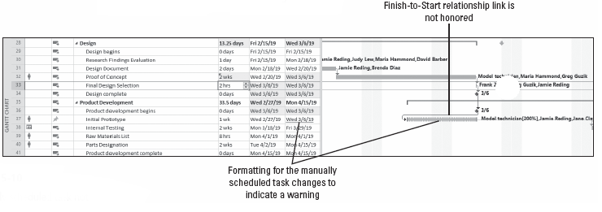
Step-by-Step: Establish a Manually Scheduled Task
Click in the duration cell of task 32, Proof of concept. Key 2w and press Enter. Your screen should look like the figure below.
Position the mouse pointer over the Gantt bar of the manually scheduled task. Right‐click on the Gantt bar of the manually scheduled task and select Fix in Task Inspector. Your screen should look like the figure on the next slide.
Notes:
Manually scheduled task not honoring its relationship with its predecessor task

Slide 28
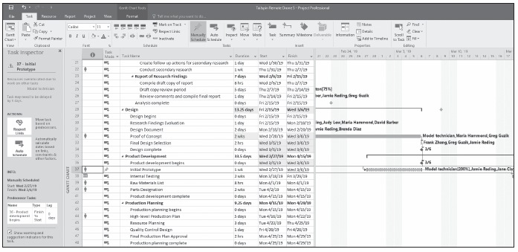
Step-by-Step: Establish a Manually Scheduled Task
Notes:
Task Inspector pane visible to make repairs to task 37
Another Way: You can also activate the Task Inspector by selecting the Inspect button on the Task ribbon.

Slide 29
Step-by-Step: Establish a Manually Scheduled Task
Review the various options and information in the Task Inspector pane. After reviewing this information, you have decided that manually scheduling this task is not the best option. In the Task Inspector pane, under the ACTIONS: section, click the Auto Schedule button. Microsoft Project returns the task to the Auto Scheduled mode. Your screen should look like the figure on the next slide.
SAVE the project schedule, and then CLOSE the file.
PAUSE. If you are continuing to the next lesson, keep Microsoft Project open. If you are not continuing to additional lessons, CLOSE Microsoft Project.
Notes:
Take Note: You can change the mode of how new tasks are entered by selecting the Task tab, selecting the Mode button, and then selecting Auto Schedule.

Slide 30
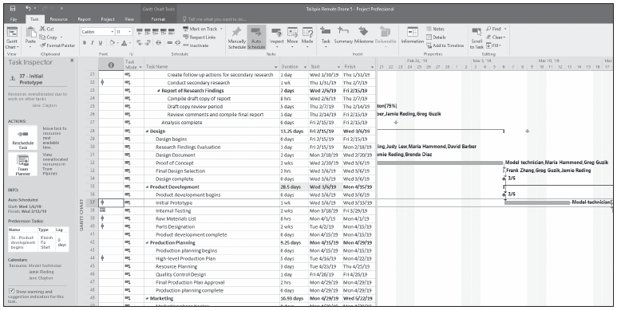
Step-by-Step: Establish a Manually Scheduled Task
Notes:
Task 37 returned to Auto Scheduled mode

Slide 31
Skill Summary

